Slide 1
CNC Dice Catcher
By:
Sebastian Villa Cuellar
Logan Morris
Alan Gregory

Slide 2
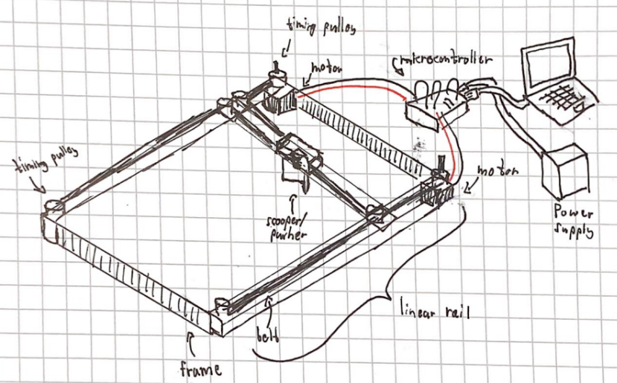
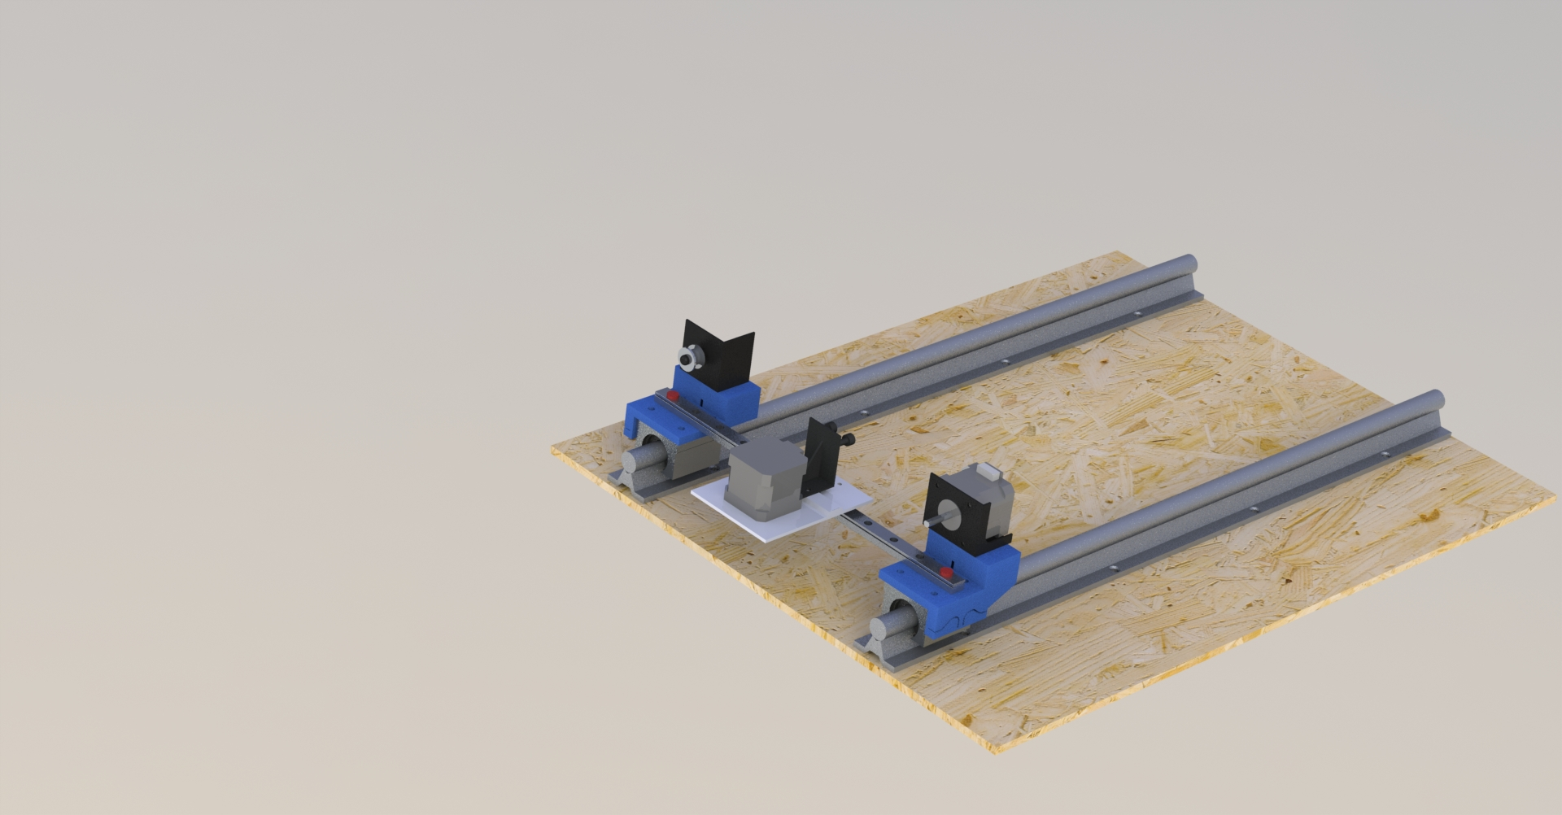
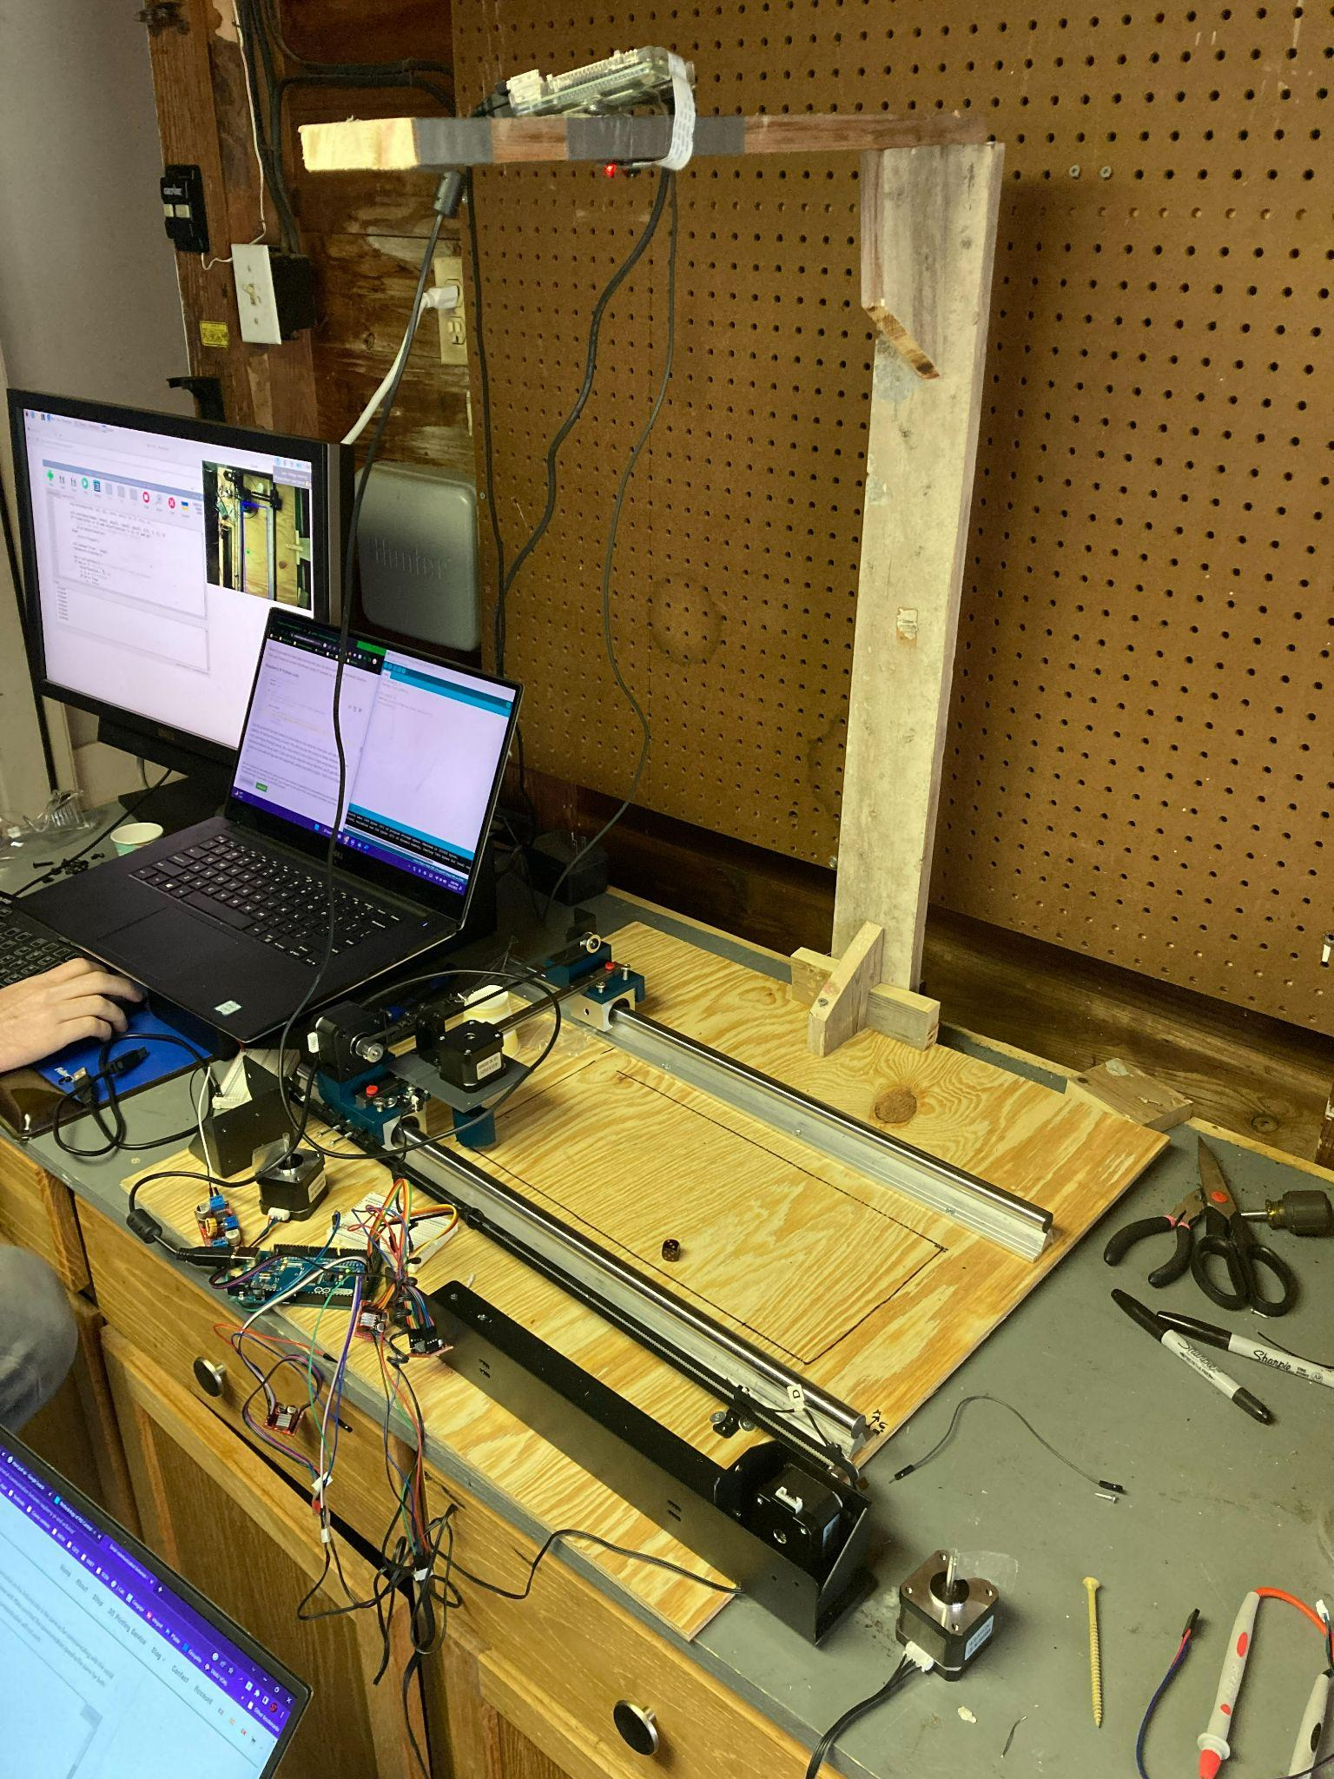
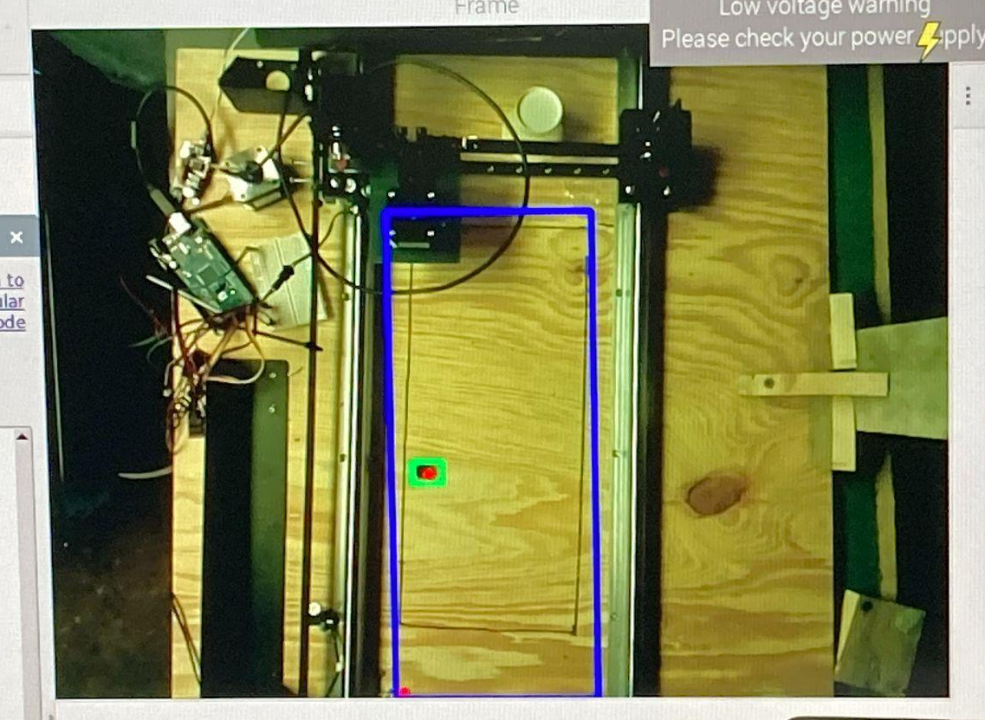
Agenda
Objectives/Significance
The Progress
The Final Product and How it Works
Areas of Improvement
Feel free to ask questions at any time!

Slide 3
Objective and Significance
Objective: make a CNC machine which can:
Detect an object in it’s grid
Move the object out of the way
Return to a specified location
Significance: Allows us to push our mechatronics skills more than class allows
Sensing a specific object with Raspberry Pi

Slide 4
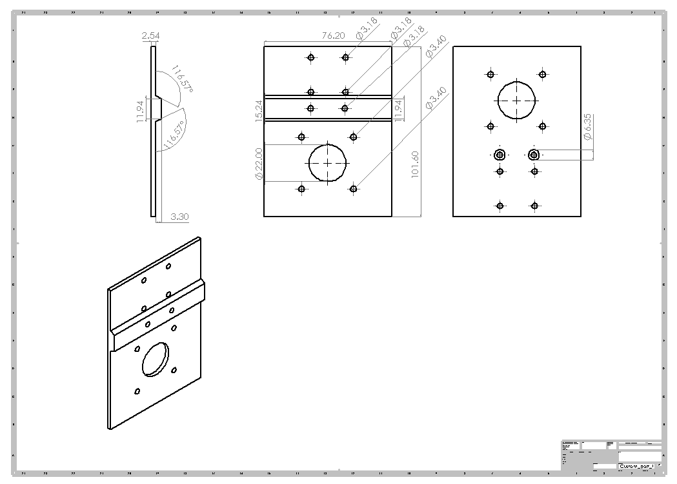
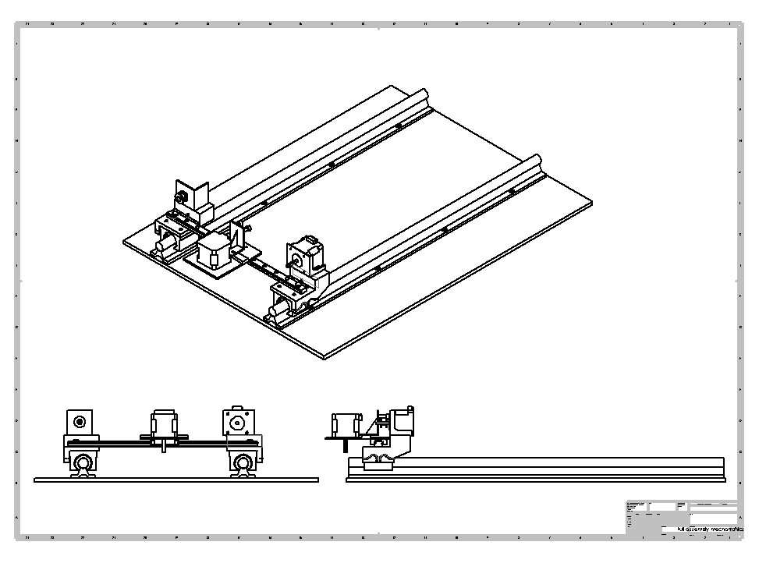
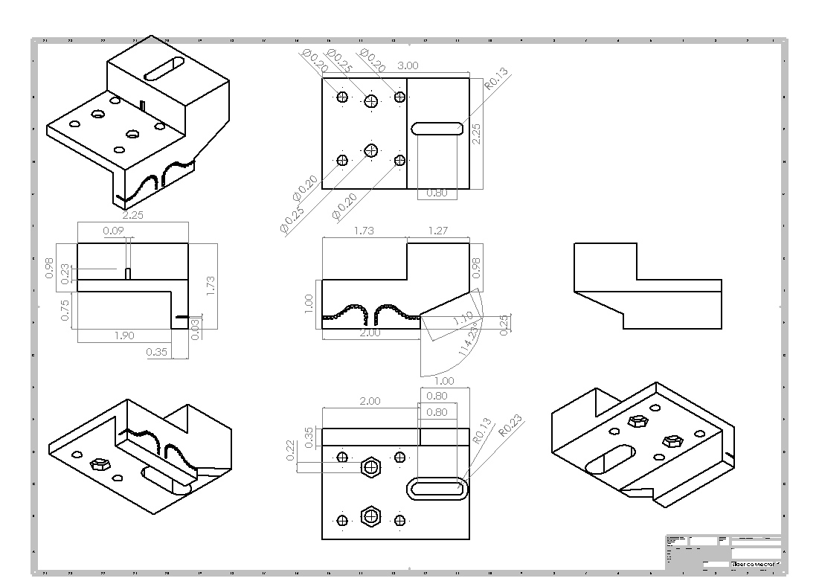
The Progress

Slide 5
The Final Product

Slide 6
How it works!
Detection
Target Acquired
Approach the Object
Push the Object
Return to Origin

Slide 7
Improvement
Working around the Raspberry Pi
Squashing serial communication bugs
Low quality drivers

